Slide 1

BGEC 103: BUSINESS COMMUNICATION WEEK 4 WRITING PROFESSIONAL EMAILS AND MEMOS

Slide 2

OUTLINE
Definition(s) and functions of Professional Emails and Memos
Purpose and Structure of Professional Emails and Memos
Tone and Language in Professional Communication
Formatting and Style Guidelines
Common Mistakes and How to Avoid Them
Ethics and Confidentiality in Emails and Memos
Sample Analyses of Professional Emails and Memos

Slide 3
LEARNING OUTCOMES
By the end of this lecture, the student should be able to:
Define professional emails and memos and describe their functions in business communication.
Explain the purpose and structure of professional emails and memos, identifying key components.
Apply appropriate tone and language in business emails and memos to maintain professionalism.
Recognize common formatting and style guidelines to enhance clarity and effectiveness.
Identify and avoid common mistakes in professional email and memo writing.

Slide 4
INTRODUCTION TO PROFESSIONAL EMAILS AND MEMOS
Professional Emails: Digital messages used for formal communication in business settings. They serve to convey information, request action, provide updates, or clarify issues.
Memos (Memorandums): Internal business documents used to communicate policies, procedures, or updates within an organization.

Slide 5
FUNCTIONS OF PROFESSIONAL EMAILS AND MEMOS
Information Sharing: Disseminating critical updates, instructions, or news.
Decision Making: Aiding in discussions, approvals, and clarifications.
Documentation: Serving as formal records of communication.
Persuasion: Convincing stakeholders about proposals, initiatives, or requests.
Professionalism: To maintain professionalism and credibility.

Slide 6
STRUCTURE OF A PROFESSIONAL EMAIL
Subject Line: Clear, concise, and informative (e.g., "Meeting Rescheduled to Friday at 10 AM").
Salutation: Formal greeting based on recipient (e.g., "Dear Mr. Asante,").
Opening Paragraph: States the purpose directly.
Body Paragraph(s): Provides necessary details with a logical flow.
Closing Paragraph: Summarizes key points and includes a call to action.
Sign-Off: Formal closing (e.g., "Best regards,") followed by name and contact information.

Slide 7
STRUCTURE OF A MEMO
Header: Includes "To," "From," "Date," and "Subject.“
Opening Statement: Directly states the purpose.
Body: Provides relevant details and supporting information.
Conclusion: Summarizes the main points and suggests next steps.

Slide 8
TONE IN BUSINESS EMAILS AND MEMOS
Formal and Professional: Respectful and structured.
Concise and Clear: Avoids unnecessary jargon and lengthy explanations.
Polite and Courteous: Uses polite language even when addressing conflicts.
Objective and Neutral: Avoids overly emotional or aggressive wording.

Slide 9
GUIDELINES FOR CLARITY AND CONCISENESS
Use Plain Language: Avoid complex vocabulary when simpler words will do.
Be Specific and Concrete: Replace vague terms with precise details.
Use Active Voice: Prefer "We will complete the project by Monday" over "The project will be completed by Monday.“
Limit Sentence Length: Keep sentences under 20 words for easy readability.

Slide 10
EXAMPLES OF TONE ADJUSTMENTS
❌ "You haven’t responded to my last two emails! What’s taking so long?“
✅ "I wanted to follow up on my previous emails regarding [subject]. Please let me know if you need any further clarification."

Slide 11
BEST PRACTICES FOR FORMATTING
Use Professional Fonts: (e.g., Arial, Calibri, Times New Roman, size 11-12).
Keep Paragraphs Short: Improves readability.
Use Bullet Points and Numbering: Helps organize content.
Avoid Excessive Capitalization: (e.g., DON’T WRITE LIKE THIS – it seems aggressive).
Use a Professional Email Address: (e.g., j.doe@company.com, not cooldude123@gmail.com).

Slide 12
COMMON MISTAKES AND HOW TO AVOID THEM
Unclear Subject Lines → Ensure clarity (e.g., "Update on Project Timeline" instead of "Important Info").
Overly Long Messages → Keep it brief and to the point.
Spelling and Grammar Mistakes → Proofread before sending. Check for redundancy, ambiguities, misspelt word etc.
Forgetting Attachments → Double-check before hitting send.
Improper Greetings and Closings → Avoid informal salutations like "Hey" or "Cheers" unless appropriate.
Using an Unprofessional Tone → Maintain a polite and respectful approach.

Slide 13
KEY ETHICAL CONSIDERATIONS
Confidentiality: Do not share sensitive information without authorization.
Professionalism: Avoid gossip, offensive language, and discriminatory remarks.
Misrepresentation: Ensure accuracy in all statements.
Plagiarism: Give credit when using information from other sources.

Slide 14
BEST PRACTICES FOR EMAIL SECURITY
Use strong passwords for email accounts.
Avoid clicking on suspicious links.
Use CC (carbon copy) and BCC (blind carbon copy) appropriately.
Double-check recipients before sending emails.

Slide 15
SAMPLE ANALYSES OF PROFESSIONAL EMAILS AND MEMOS
Example 1: A Well-Written Email
Subject: Request for Meeting Reschedule
Dear Dr. Mensah,
I hope you are doing well. I am writing to request a reschedule of our meeting originally set for Wednesday at 3 PM due to a scheduling conflict. Could we move it to Thursday at the same time? Please let me know if this works for you.
Thank you for your time and consideration.
Best regards,
John Doe

Slide 16
SAMPLE ANALYSES OF PROFESSIONAL EMAILS AND MEMOS
Example 2: A Poorly-Written Memo❌
Subject: Policy Change
Hey everyone,
Just letting you know there’s a new policy about taking days off. If you need more info, talk to HR.
Thanks.
Why is this ineffective?

Slide 17
SAMPLE ANALYSES OF PROFESSIONAL EMAILS AND MEMOS
No clear explanation of the policy change.
Informal and vague.
No details on next steps. ✅ A good memo would include the policy specifics, effective date, and instructions for employees.

Slide 18
GROUP EXERCISE
Students will be divided into groups and assigned different scenarios.
Each group will draft a professional email or memo based on the scenario.
Groups will present their drafts for peer review and discussion.

Slide 19
Final Tips for Writing Professional Emails and Memos
Be clear, concise, and professional.
Use a structured format.
Maintain a polite and neutral tone.
Proofread before sending.
Keep ethical considerations in mind.

Slide 20
REFERENCES
Guffey, M. E., & Loewy, D. (2022). Essentials of business communication (11th ed.). Cengage Learning.
Potter, R. L., & Hylton, T. (2024). 9.2 Correspondence: Text messages, emails, memos, and letters. Technical Writing Essentials: NSCC Edition.

Slide 21
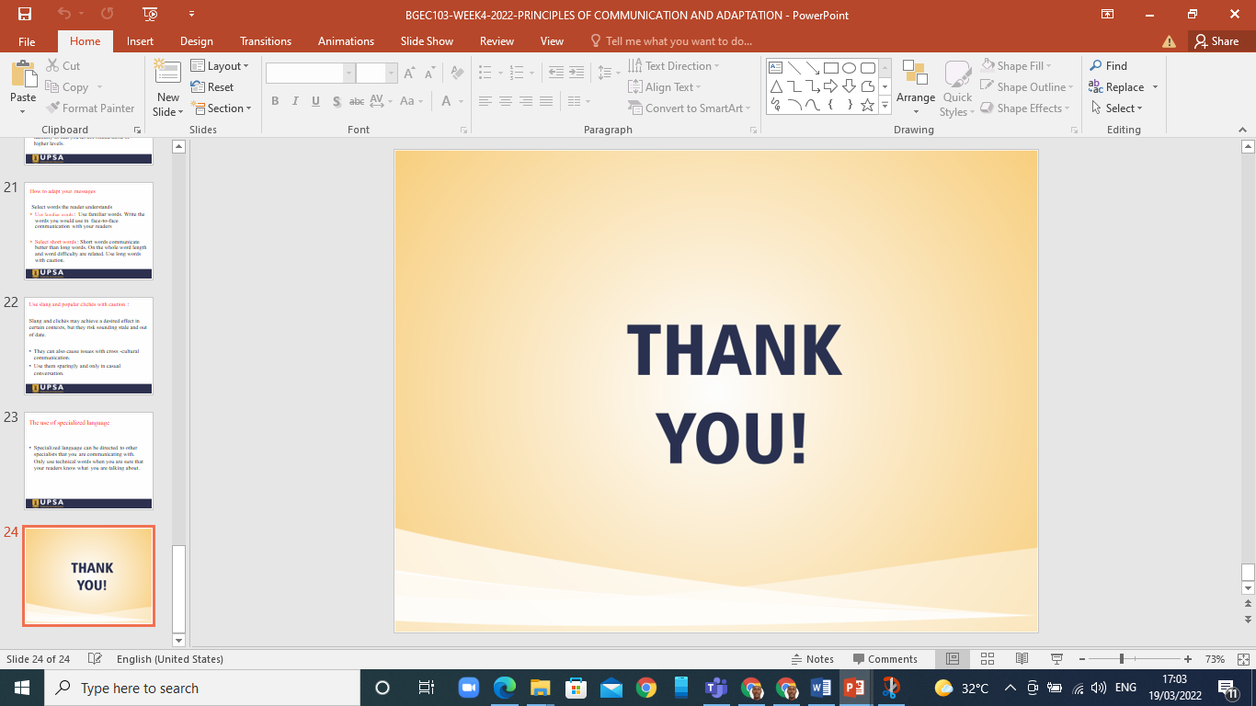

Slide 22
Q & A

